Slide 1
NEF property Webinar
Together Building South Africa,
Brick by Brick
Zama Khanyile
Fund Manager
National Empowerment Fund

Slide 2
NEF Mandate…
Established by the
National Empowerment Fund Act No. 105
of 1998, the NEF is an agency of the dtic and
is a driver and a thought-leader in promoting and facilitating black economic participation through the provision of financial and non- financial support to black-owned and managed businesses, as well as by promoting a culture of savings and
investment among black people.
The only DFI exclusively mandated to grow B-BBEE
NEF funds across all sectors of the economy from R250 000
up to R75 million

Slide 3
The NEF’s strategic outcome-oriented goals
To provide finance to business ventures established and managed by black people
Invest in black empowered businesses that have high employment creating opportunities
Support the participation of black women and youth in the economy
Maximise support for township and rural economies
Facilitate investment across all provinces in South Africa
Advance black economic empowerment through commercially sustainable enterprises
Establish the NEF as a financially sustainable DFI in South Africa

Slide 4
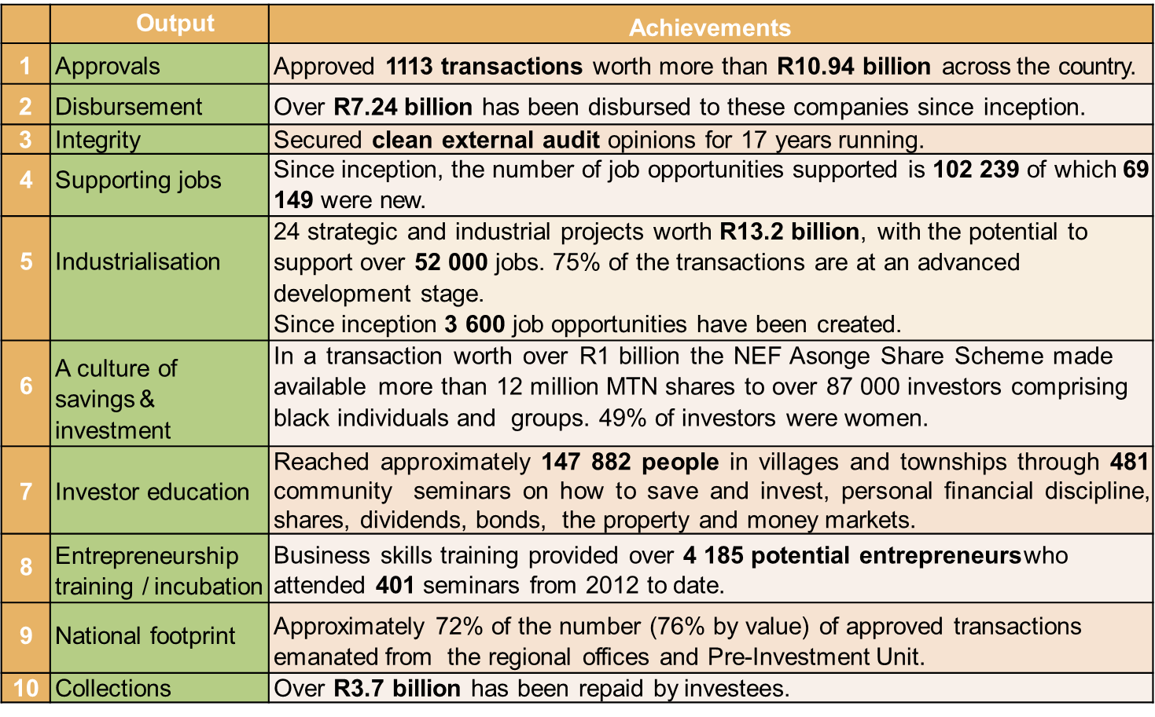
Life to date performance milestones

Slide 5
NEF Investment Funds
 | uMnotho | iMbewu | Strategic Projects Fund | Rural and Community Development | Women Empowerment Fund
Objectives | Provides capital for expansion of businesses, the buying of shares in white-owned businesses or funding new ventures | Supports start-up businesses Provides capital for the expansion of small enterprises | Funds the development of projects through stages of projects | Supports the development and growth of a rural economy in rural communities, which is achieved by the mobilisation of structures such as cooperatives | •Supports businesses that are more than 50% owned and managed by black women
Products | • Acquisitions • New Ventures • Expansion • Capital Markets Liquidity and Warehousing | • Franchise financing • Procurement/ Contract • Entrepreneurship funding | • Venture Capital funding structures • Development of Black Industrialist funding in strategic sectors | • New Ventures • Business Acquisition • Expansion | The product offerings cut across all products provided by the different Funds
Range | Funding ranges from R2 million to R75 million | Funding from R250 000 to R15 million | Funding up to R75 million | Funding ranges from R1 million to R50 million | Funding from R250 000 to R75 million

Slide 6
NEF’s Performance
and Investment Criteria…
“The Empowerment Dividend”
The assessment of impact is not driven only by financial returns but by measurement in terms of “The Empowerment Dividend” made up as follows:
Broad Based Black Economic Empowerment
Ownership, management control, employment equity, value chain (suppliers) etc.
Black Women Empowerment
Job Creation
Growth Sectors
Geographic Spread
Investment Return

Slide 7
NEF Property Portfolio

Slide 8
Achieved Milestones to date
The NEF is a key strategic player in the property funding space:
30 transactions approved worth over R773.4 million
Disbursed approximately R682 million
Since inception, R533m has been repaid by the investees. The NEF has collected 81% of the invested capital.
Achieved 30% exits
NEF investments in the property sector have unlocked more than R1.5 billion in third party funding
Over 7 628 jobs created
28% of the funded transactions are owned and managed by women
Strong strategic co-funding partnerships with other property finance institutions (GPF, SHRA and SA Homeloans)
85% of the funded transactions are owned and managed by women

Slide 9
The NEF as a responsive DFI
The NEF has learned lessons and yielded successes as evidenced by the size of portfolio and the achieved socio-economic impact ( jobs, rural and community development).
A strategic imperative for the NEF. Property ownership and development is fundamental to the creation of both employment and wealth, and is a pivotal to economic freedom and transformation tool in South Africa.
The NEF has unlocked artificial barriers to entry through de-risking construction risks for commercial banks
NEF playing a crucial role in addressing the market failure where banks may not support black entrepreneurs in the property sector due to:
Lack of industry experience and track record;
The high risk perceived to be associated with the construction of greenfield projects; and
The typical loan-to-value ratio not being met as black entrepreneurs do not have sufficient own contribution.

Slide 10
NEF Participation in Property Value Chain

Slide 11
New Property Product: Criteria

Slide 12
How to Qualify for Funding: checklist
Signed application form
Land ownership structure
Business plan
Nature of business
Shareholding and management
Market feasibility
Financials
Existing business: 3 year historical financials
New business: 5-10 year financial projections
Property management overview
Town Planning Approvals and Environmental Authorisations
Professional team

Slide 13
Lessons Learnt
Success in this sector depends on the following key factors
A strong experience Investee with financial management and sector experience and will be actively operationally involved in the business is key
Investee must be financially disciplined and not deviate from the project scope without notifying the Funder
A strong technical team, particularly the contractor, Project Manager, Quantity Surveyor and Architect. Technical teams must be independent
Time taken to get municipal approvals could cause delays. Municipal approvals, such as rezoning typically take longer than 6 months to be obtained. A zoning certificate is a key screening document for the NEF. Building plan approvals takes between 3 months and 6 months.
Perform a Geotech and a structural assessment if an old building is being acquired
Location plays an important role for student housing projects. Security, distance, access to transportation and how many other similar properties are located in the area must be considered

Slide 14
A Sample of NEF Investees

Slide 15
YG Properties - R40.6 million NEF Investment
YG properties is a 100% black owned company that was founded to house the construction of 312 social housing apartments in Kempton Park for R126m, in Ekurhuleni, to be known as Kempton Village. Its scale and magnitude, developmental essence and the entrepreneurial spirit that birthed it, define the courage and vision of the NEF and its co-funders.
Co-funded with SHRA.
Completed on Budget and on time.
The NEF approved R40.6 million to fund construction costs. SHRA approved a grant of R85 million.
The project created over 330 jobs, including 10 permanent jobs

Slide 16
Ordicode – Social Housing & Student Accommodation R27 million
Ordicode (Pty) Ltd trading as Bataung Heights is a property development of residential units and retail space. The property is located in Joubert Park, Johannesburg within 5 minutes walking distance to Park Station, Gautrain Station and Metro rail , and both Wanderers MTN Taxi rank and The Bridge Shopping Centre. This project was a green field development with retail on the ground floor plus 8 storeys of 106 2-bedroom affordable housing units. The ground floor is 100% let to Shoprite U-Save on a commercial lease.
The property development is worth R50 million in the Johannesburg CBD which has received R27 million funding from the NEF. GPF approved a R19.6 million junior loan.
The project created 343 construction jobs and 15 permanent jobs. The Company is 85% woman-owned and 15% owned by a student trust.

Slide 17
Tshellaine Holdings (Pty) Ltd- R34.5 million
Construction of a 264 bed student accommodation in the South of Johannesburg
Co-funded with GPF
Tshellaine Holdings (Pty) Ltd is a 100% black youth owned and 50% black-woman-owned business. The business started small by sub-leasing one unit, a two bedroom apartment with a kitchen, bathroom to University of Johannesburg (UJ) Soweto Campus students.
Tshellaine used the first unit to apply for Off-campus Housing Accreditation with UJ and was granted accreditation in 2013 to accommodate 56 students. The directors then approached Southgate Ridge, owned by IHS Property Management, for rental space and managed to get 9 units and 36 beds. The 56-bed accreditation turned into 104 beds in 2015 and 160 beds by 2017. Tshellaine is currently accredited for 200 beds by UJ and has been fully operational at 100% capacity since 2012, from the property at Southgate Ridge.
The project was co-funded with GPF. GPF approved R15.2 million.
255 jobs created ( including10 permanent jobs)

Slide 18
Nare Leisure Investment (Pty) Ltd – Boutique hotel R10 million
Nare Leisure Investment (Pty) Ltd was established in 2018 with the purpose of establishing a 4-star top-end Boutique Hotel in Kimberly, Northern Cape. The hotel currently under construction is 100% black women-owned. The owner identified the opportunity through her involvement with International Convention Solution (ICS), a related company, that managed Mittah Seperepere Convention Centre for the past six years. Through the years the convention centre needed to build capacity to host big events such as Sports Awards, Metro FM Awards and many more due to a lack of proper accommodation in the region. Furthermore, Kimberly as the capital city of the Northern Cape hosts various local and provincial Government events and colloquiums extending over more than one day which results in accommodation being required for out of town guests.
The boutique hotel will consist of 13 rooms and a roof-top hosting facility with a capacity of 50 individuals
The NEF approved R10 million to fund land purchase and construction costs.
The project created 72 jobs, including 16 permanent jobs

Slide 19
South Hill Trading – Boutique hotel R14.9 million
South Hill Trading (Pty) Ltd is a100% black women owned company was established with the purpose of acquiring, renovating, and operating a 4-star top-end Boutique Hotel trading as Luxe Boutique Hotel based in Upington, Northern Cape. It is owned by Zuri Concepts and Projects (Pty) Ltd, an existing travel agency that predominantly services corporates and state-owned entities regarding their travel requirements. Through the travel agency, the owner identified the opportunity to establish a Boutique Hotel in Upington as they are experiencing substantial travel requests for that area due to the vast business activity.
NEF approved R14.9 million to fund construction costs. The hotel will be called the Luxe Boutique Hotel of Schroeder and will consist of 13 bedrooms which will constitute of 10 queen bed bedrooms, 3 twin single bed bedrooms.
Approximately 49 jobs will be created, including 12 permanent jobs.

Slide 20
THANK
YOU

